Slide 1
GARBAGE CLASSIFICATION using Convolution Neural networks
Submitted to:
Dr. Rashmi Gupta Deep Learning
Submitted by:
Naman
ECAM-2
2020UEA6598

Slide 2
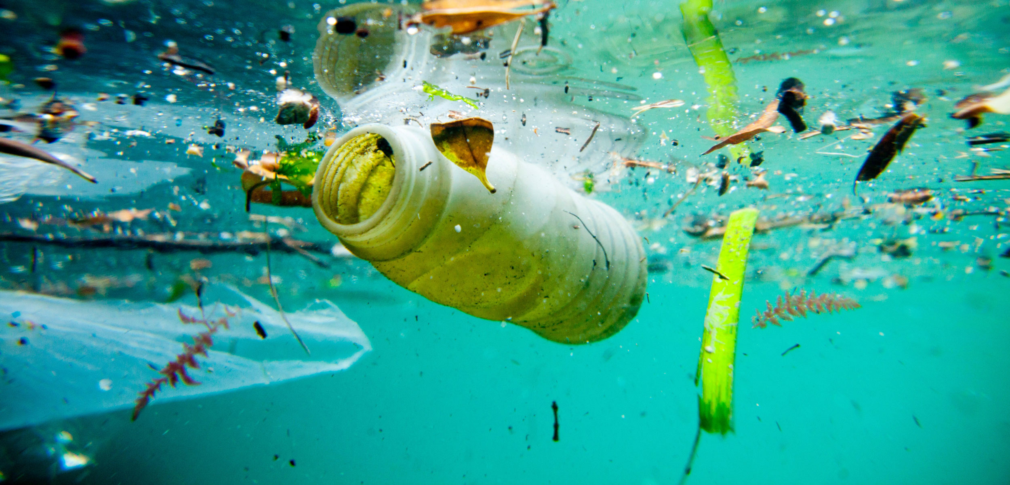
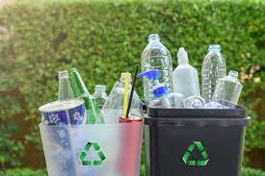
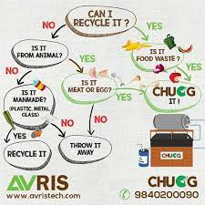
OBJECTIVE
To develop a CNN model that can classify garbage images with high accuracy.
To differentiate between recyclable and organic garbage.
Recycling helps prevent waste of useful materials, reduces energy consumption, air pollution, and water pollution.
To promote sustainable waste management practices through efficient garbage classification.

Slide 3
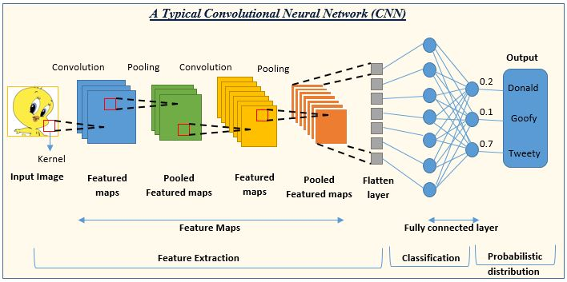
Theory behind a cnn
Convolutional Neural Networks (CNNs) are a type of deep learning algorithm used for image and video recognition, natural language processing, and many other applications.
The fundamental idea behind CNNs is to mimic the visual processing of the human brain, where neurons respond to specific regions of the visual field.
CNNs are made up of multiple layers, each with a specific task

Slide 4
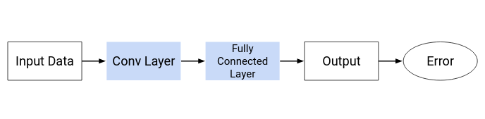
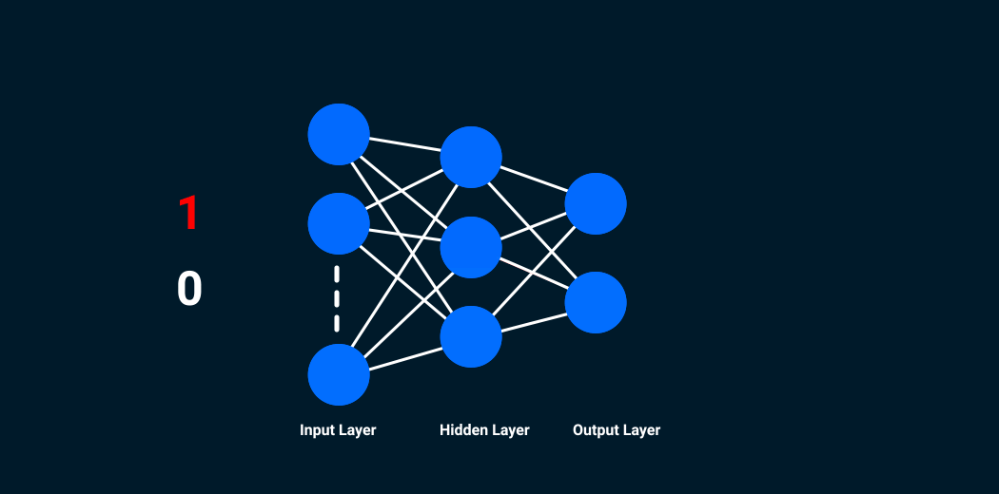
CNN Architecture
The convolutional neural network can be broken down into two parts:
The convolution layers: Extracts features from the input
The fully connected (dense) layers: Uses data from convolution layer to generate output
There are two important processes involved in the training of any neural network:
Forward Propagation: Receive input data, process the information, and generate output
Backward Propagation: Calculate error and update the parameters of the network

Slide 5
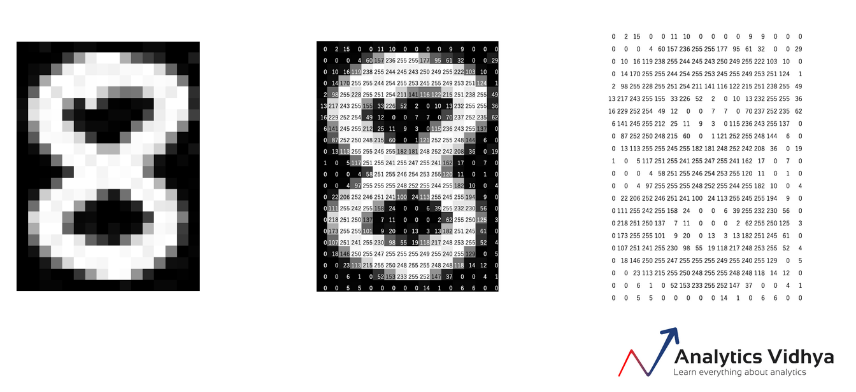
Convolution Layer
A convolutional neural network looks at images and identify the object’s shape and edges by comparing the pixel values.
On right hand side is an image of the number 8 and the pixel values for this image.
We can see that there is a significant difference between the pixel values around the edges of the number.
Hence, a simple way to identify the edges is to compare the neighboring pixel value.

Slide 6
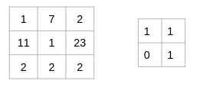
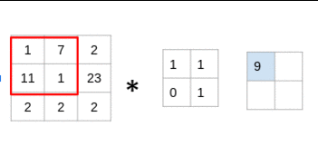
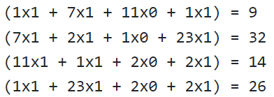
Math and process behind a convolution operation
Consider that we have an image of size 3 x 3 and a filter of size 2 x 2:
The filter goes through the patches of images, performs an element-wise multiplication, and the values are summed up:

Slide 7
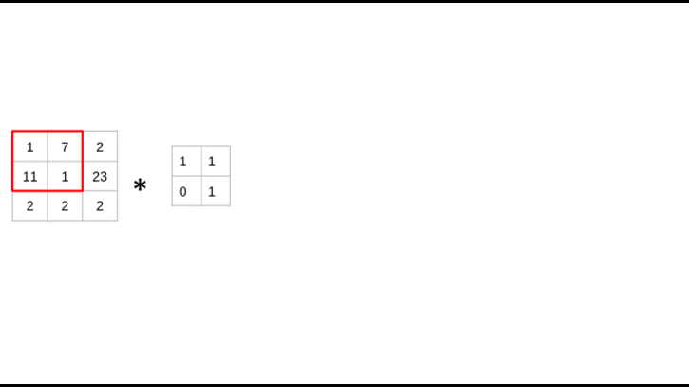
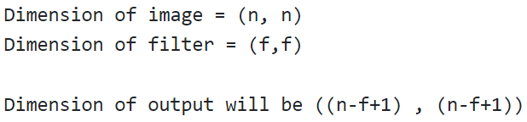
The filter is considering a small portion of the image at a time. We can also imagine this as a single image broken down into smaller patches, each of which is convolved with the filter.
To find the shape of an output for more complex inputs or filter dimensions, the formula goes as:

Slide 8
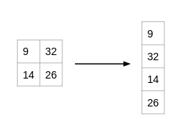
Fully connected(dense) layer
The output from the convolution layer was a 2D matrix.
Ideally, we would want each row to represent a single input image. In fact, the fully connected layer can only work with 1D data. Hence, the values generated from the previous operation are first converted into a 1D format.
Once the data is converted into a 1D array, it is sent to the fully connected layer. All of these individual values are treated as separate features that represent the image.
The fully connected layer performs two operations on the incoming data – a linear transformation and a non-linear transformation.

Slide 9
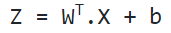
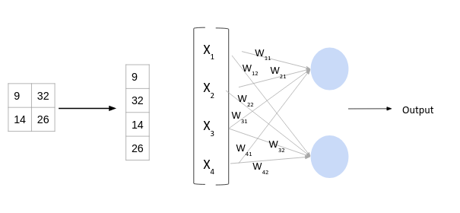
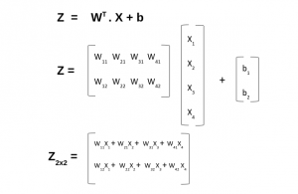
1. Linear transformation
The equation for linear transformation is:
Here, X is the input, W is weight, and b (called bias) is a constant.
Considering the size of the matrix is (m, n) – m will be equal to the number of features or inputs for this layer. Since we have 4 features from the convolution layer, m here would be 4.
The value of n will depend on the number of neurons in the layer. For instance, if we have two neurons, then the shape of weight matrix will be (4, 2)

Slide 10
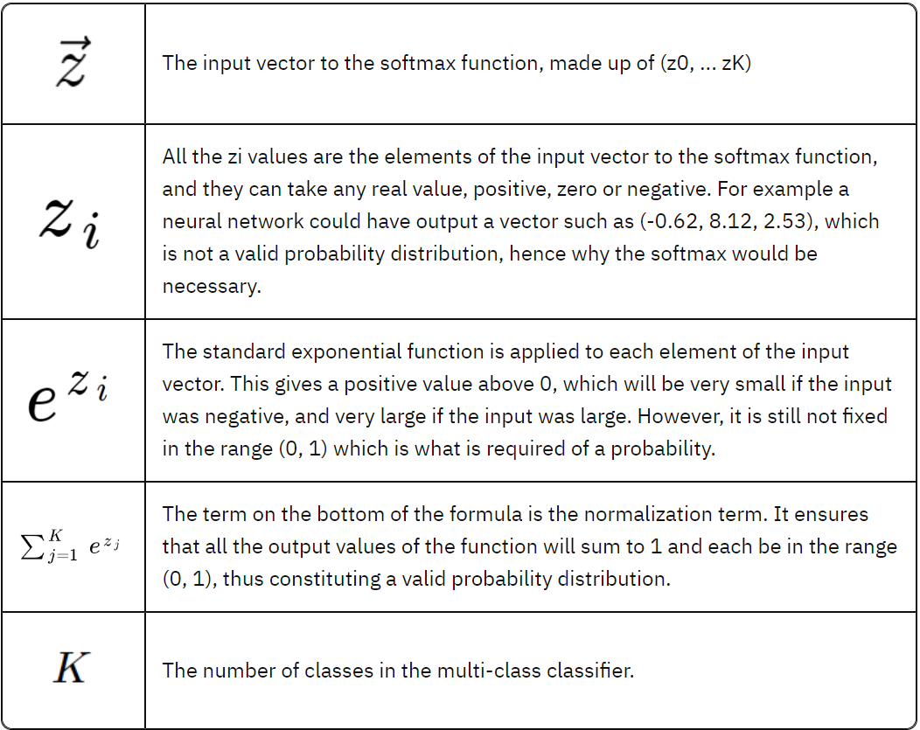
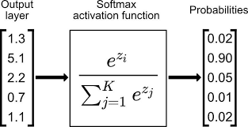
2. NON - Linear transformation
The linear transformation alone cannot capture complex relationships. Thus, we introduce an additional component in the network which adds non-linearity to the data.
This new component in the architecture is called the ”Activation Function”.
The one we are working with in our model is:
SOFTMAX ACTIVATION FUNCTION:
It is especially used for multiclass classification problems.
It is applied to the output layer of a neural network, and its
purpose is to transform the raw output values into a
probability distribution over the predicted classes.

Slide 11
ABOUT PROJECT CODE

Slide 12
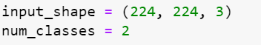
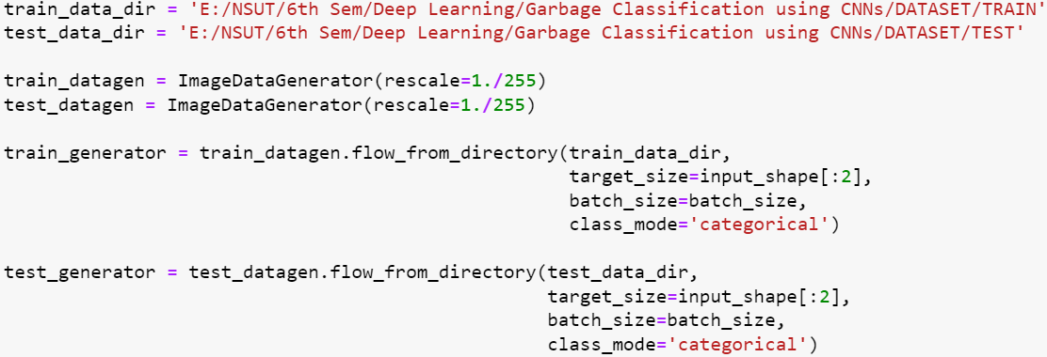
DATA PREPROCESSING
Specify input image size and number of classes in the input data.
Creating Data Generators:
Set rescale parameter to 1./255 to normalize pixel values to be between 0 and 1.
Resize images to dimensions specified in target_size.
Convert images to batches of data with number of images equal to batch_size parameter.
Set class_mode parameter to 'categorical' to represent labels in one-hot encoded format.

Slide 13
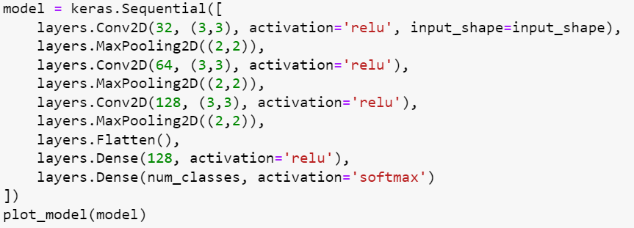
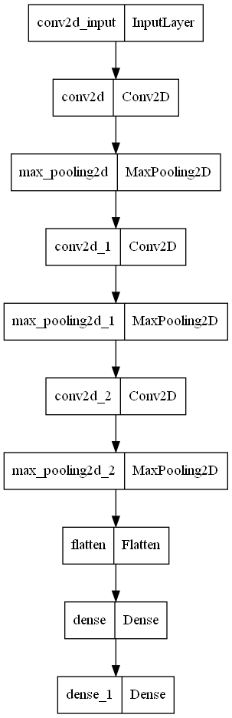
Model architecture
Model architecture
Conv2D layer creates a convolutional layer with 32, 64, and 128 filters of size 3x3.
Activation parameter is set to 'relu' for applying the rectified linear unit activation function to each neuron output.
MaxPooling2D layer creates a pooling layer that downsamples convolutional layer output by taking the maximum value in each 2x2 region.
Flatten layer flattens the output of convolutional layers into a 1D vector, which is passed to fully connected layers.
Dense layers create fully connected layers with 128 and num_classes neurons.
Activation parameter is set to 'relu' for the first dense layer and 'softmax' for the second dense layer.
'Softmax' activation function outputs a probability distribution over possible classes used for multi-class classification.

Slide 14
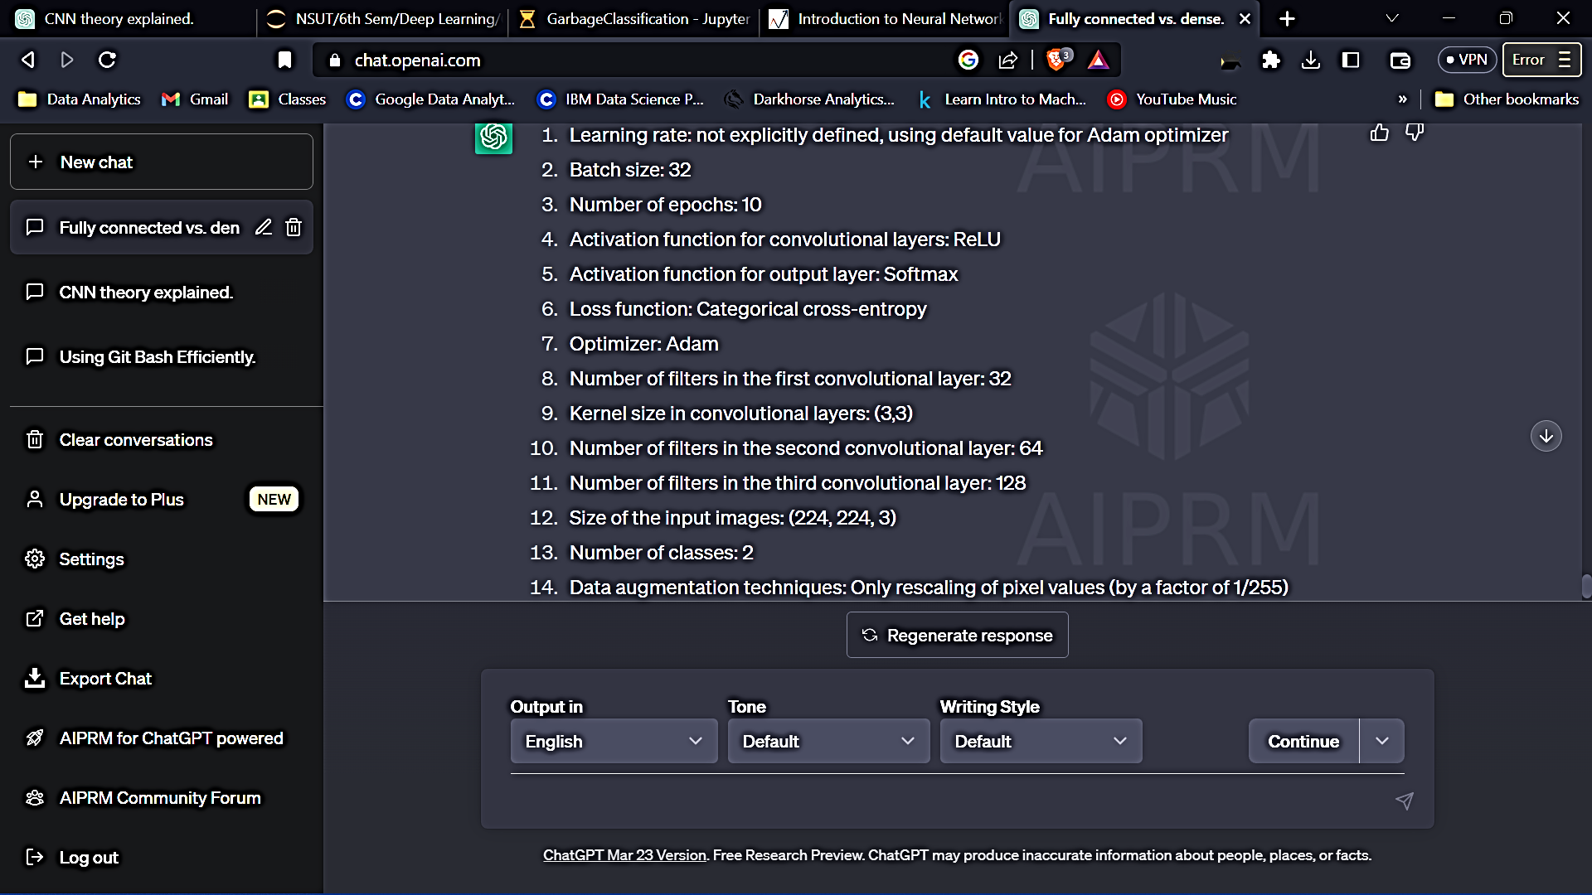
Hyperparameters chosen
We chose the following hyperparameters;
input_shape: The input image size to the CNN model.
num_classes: The number of output classes.
batch_size: The number of samples that will be propagated through the network in each iteration during training.
epochs: The number of times the training dataset is iterated over while training the model.
optimizer: The algorithm used to optimize the weights of the model during training.
loss: The loss function used to measure the difference between predicted and actual output values during training.
metrics: The performance metric used to evaluate the performance of the model during training and testing.
learning_rate: The rate at which the model's weights are updated during training.
kernel_size: The size of the convolutional kernel used in the convolutional layers.
activation: The activation function used in the layers of the CNN model.

Slide 15
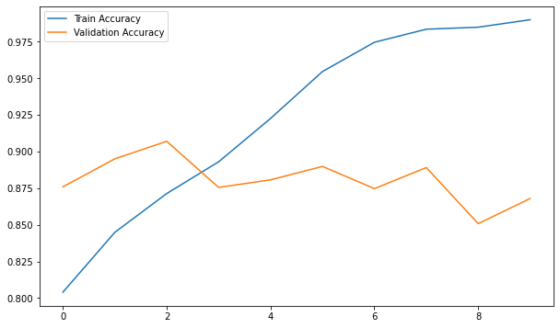
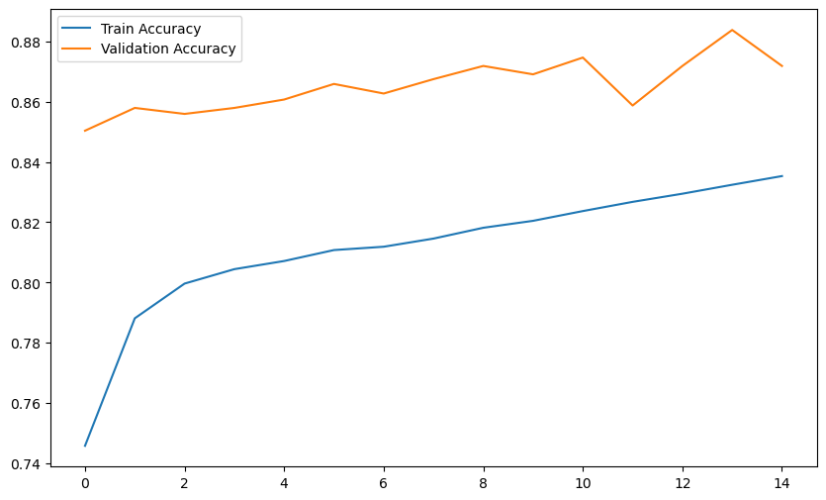
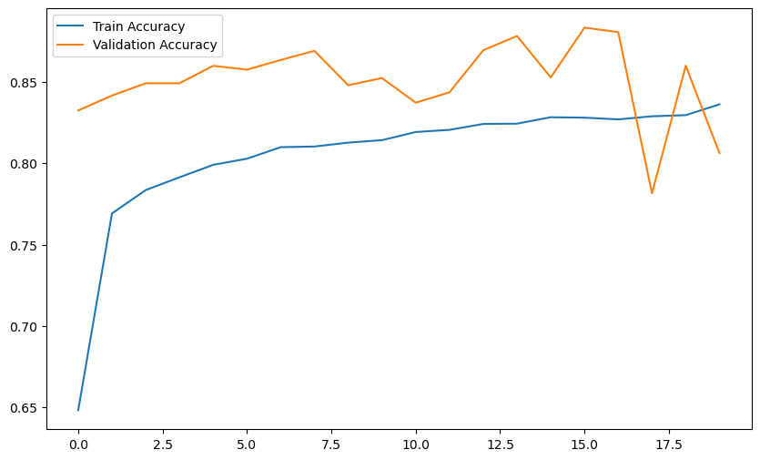
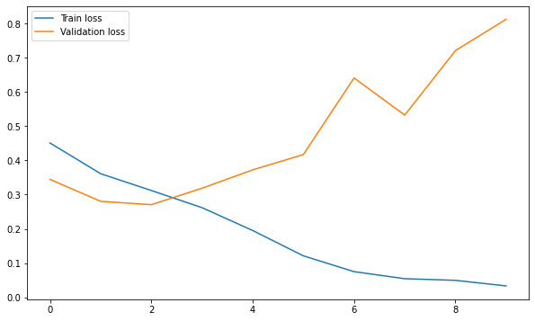
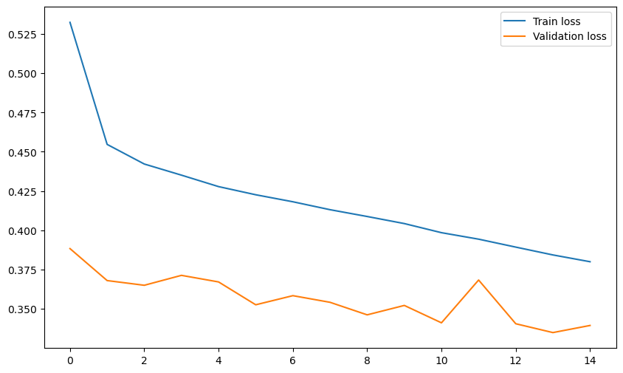
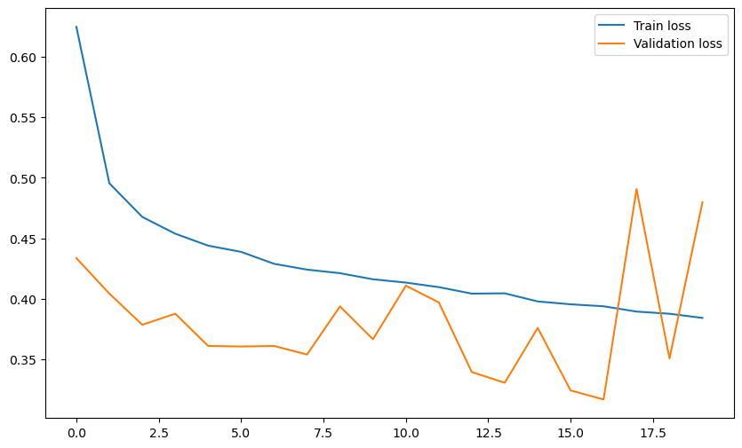
Hyperparameter optimization
1.
No. of convolution layers: 3
Batch size: 32
No. of epochs: 10
Optimizer used: adam
2.
No. of convolution layers: 4
Batch size: 64
No. of epochs: 15
Optimizer used: adagrad
3.
No. of convolution layers: 6
Batch size: 128
No. of epochs: 20
Optimizer used: sgd
loss: 0.8447 - accuracy: 0.8846
loss: 0.3395 - accuracy: 0.8719
loss: 0.4797 - accuracy: 0.8062

Slide 16
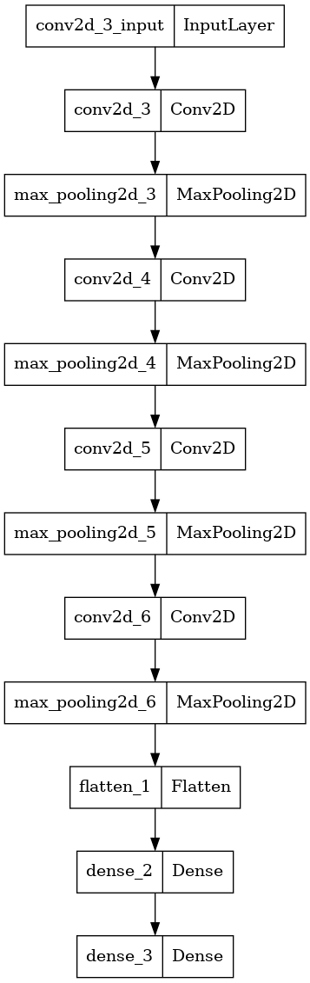
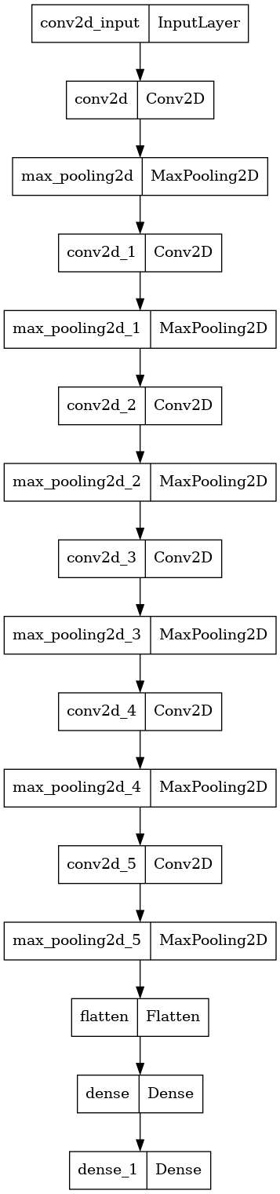

Slide 17
MODEL PERFORMANCE
The model achieved 89% validation accuracy after 10 epochs, with decreasing training and validation loss indicating improvement.
The test accuracy was around 90%. Nonetheless, the model's overall performance may vary based on the dataset and problem being tackled.

Slide 18
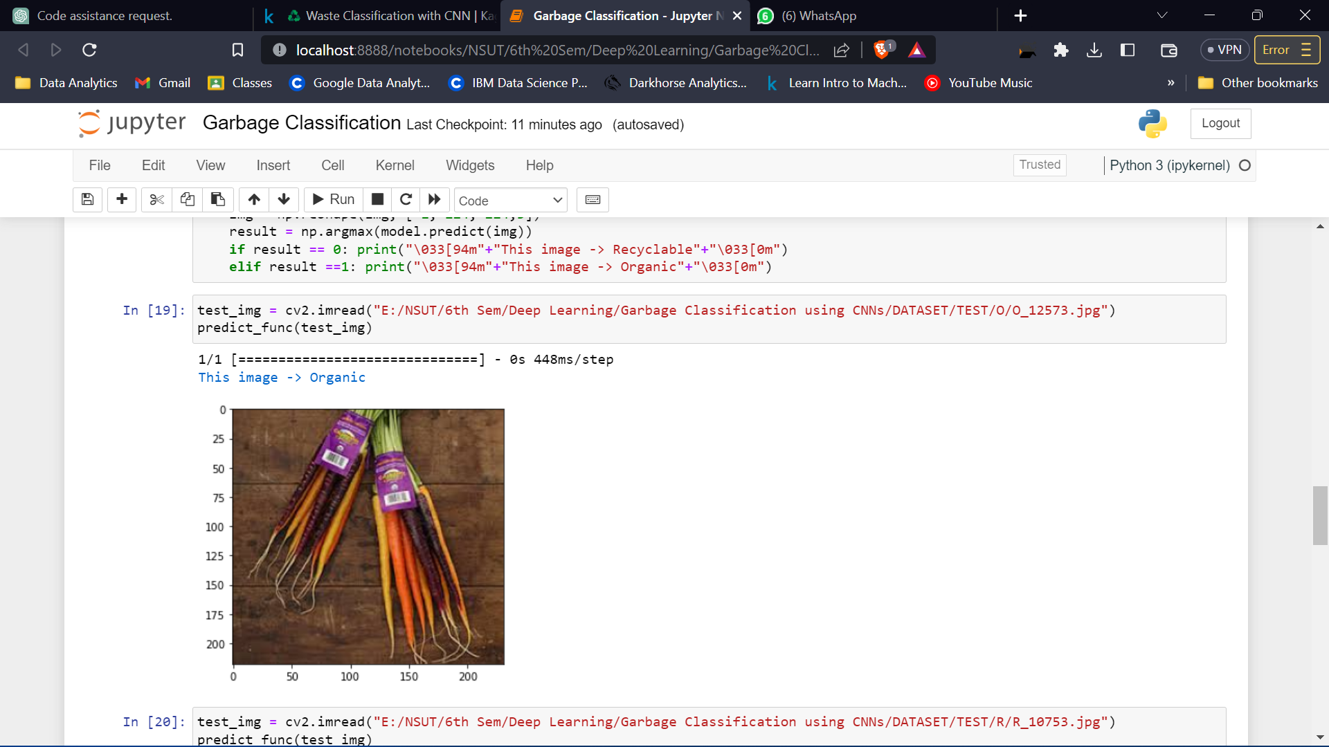
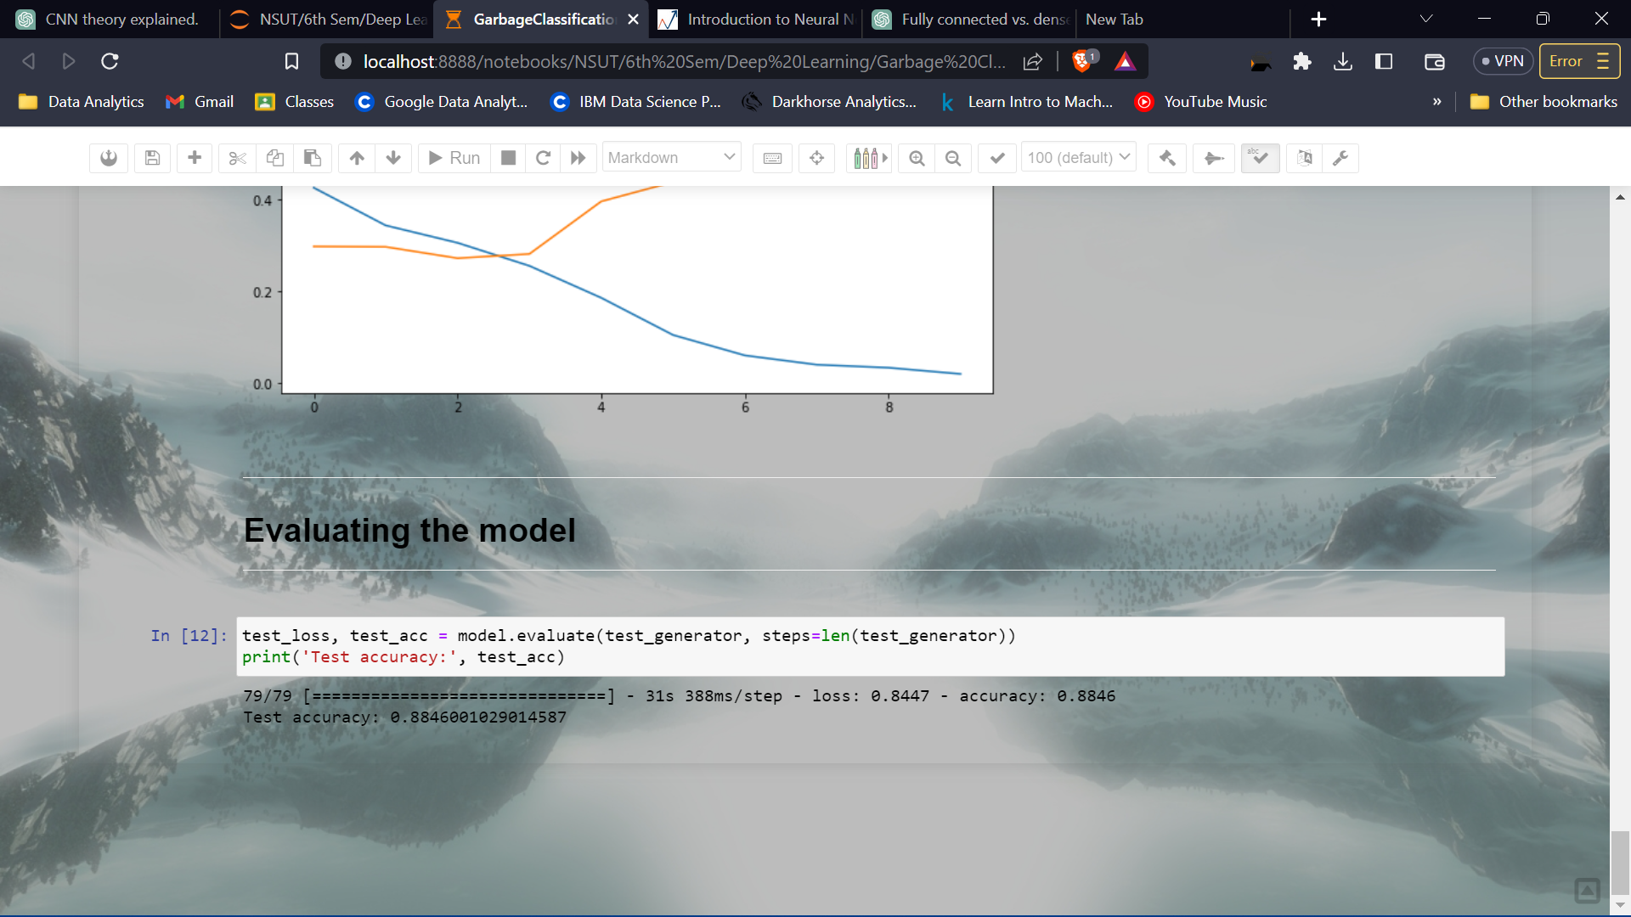
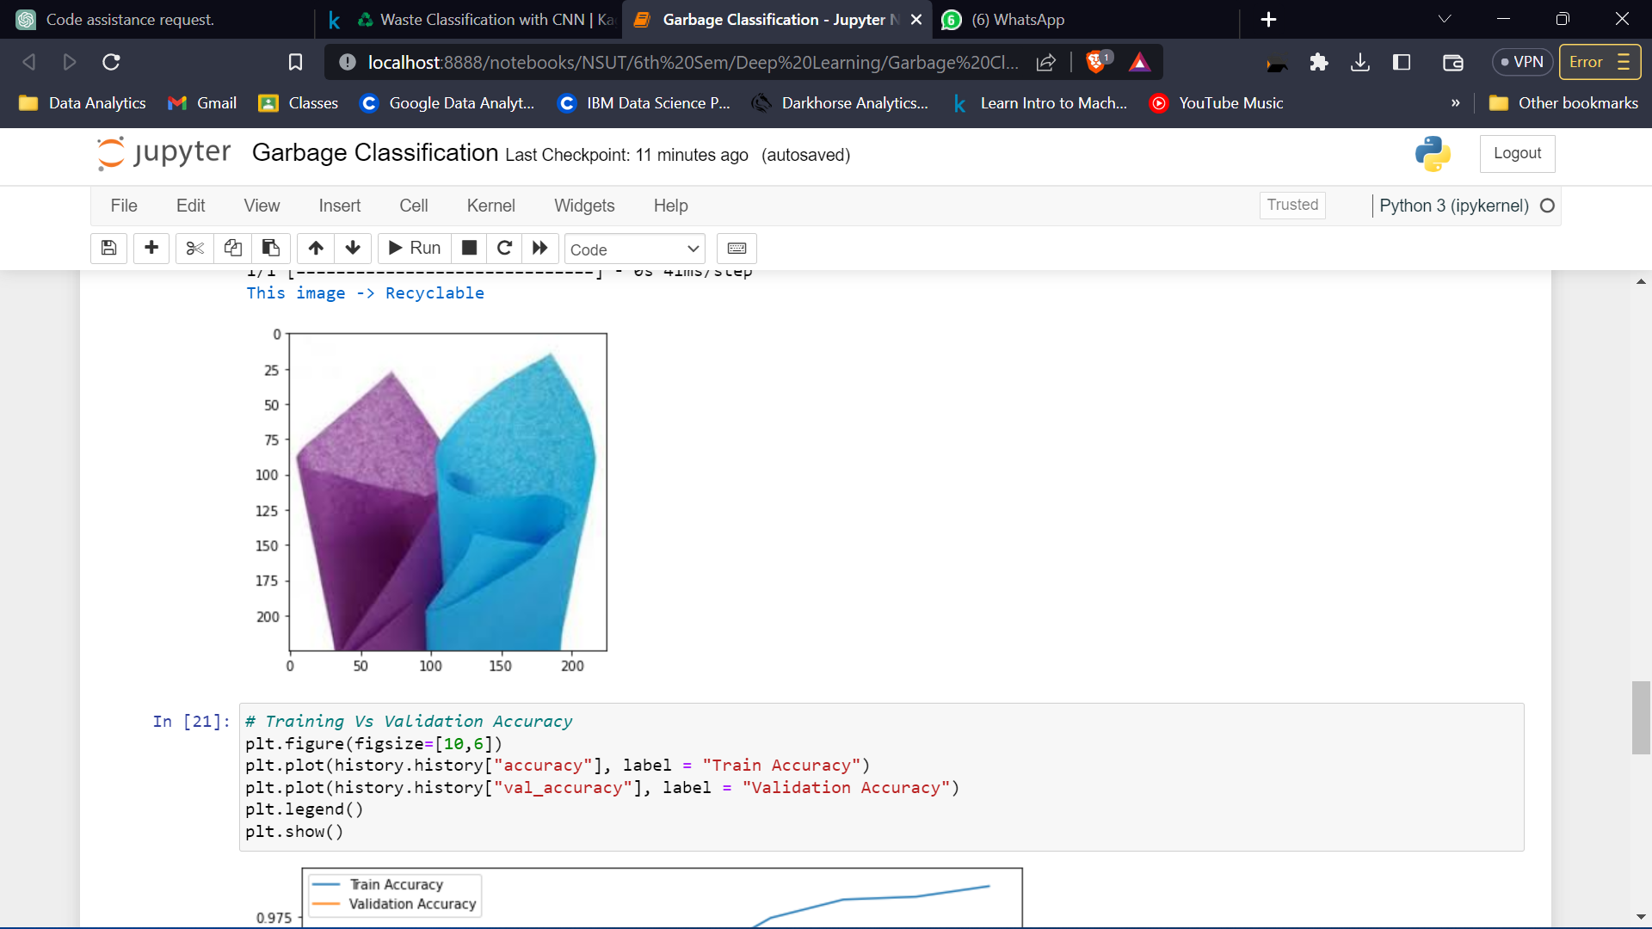
Results & conclusion
Successfully able to classify input image of garbage into: Organic or Recyclable, with test accuracy up to 89%.
Scope of improvements;
Increasing the dataset size
Fine-tuning hyperparameters
Adding more convolutional layers
Experimenting with different optimizers and learning rates
Use pre-trained architectures such as ResNet, DenseNet or AlexNet etc.

Slide 19
References
dataSearch. research.google.com
TowadsdataScience.com
Github.com
Project Repository
Kaggle.com Dataset
Analytics Vidhya
Web link

